Slide 1


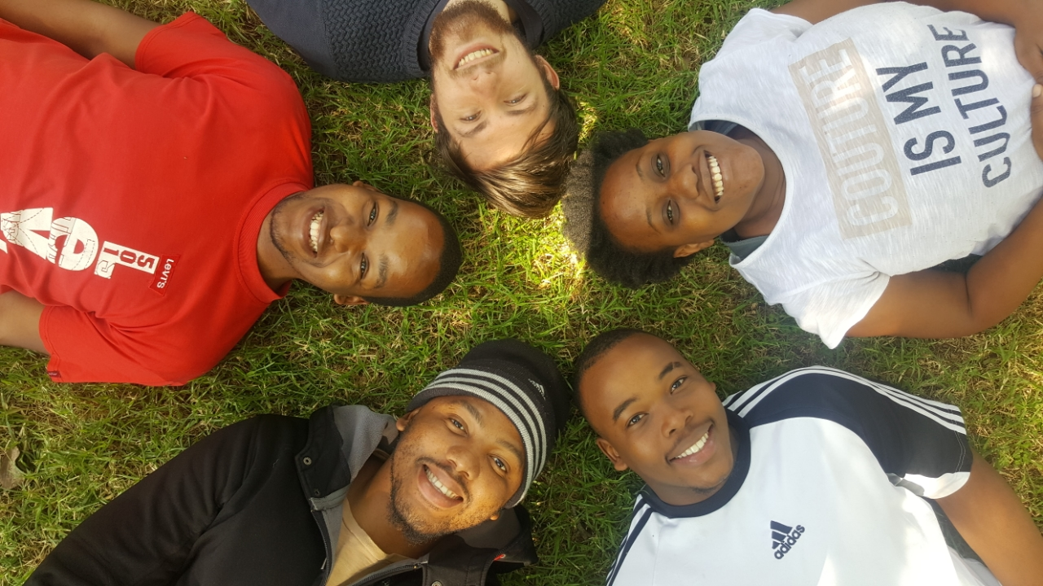
INDOOR MALL NAVIGATION
BRUTE FORCE

Slide 2

PROJECT DESCRIPTION
Create a fully interactive mall guide of sorts which will allow users to easily find shops as well as act as a shopping companion, providing a list of available specials within a store based on location as well as allowing users to add items to a shopping cart to purchase and have delivered later. This system also aims to replace electronic maps using augmented reality to guide users to a selected store.

Slide 3
TEAM SCHEDULING AND PLANNING
Planning and Admin Meetings – twice a week Monday (14:30-15:00) and Friday (16:30 – 17:00)
Team Coding Sessions – Monday (15:00-16:30) and Friday (14:00 – 15:30)
The team has resolved to this solution to assist in collaboration and general team problem solving

Slide 4
System Architecture
Client-Server - Main System (Client: Indoor Mall Navigation Application, Server: Database Management System)
Micro-services – Each Client (Application)
MVC – Micro-services Provided by Each Client
Object-Persistence Framework – Database Management System

Slide 5
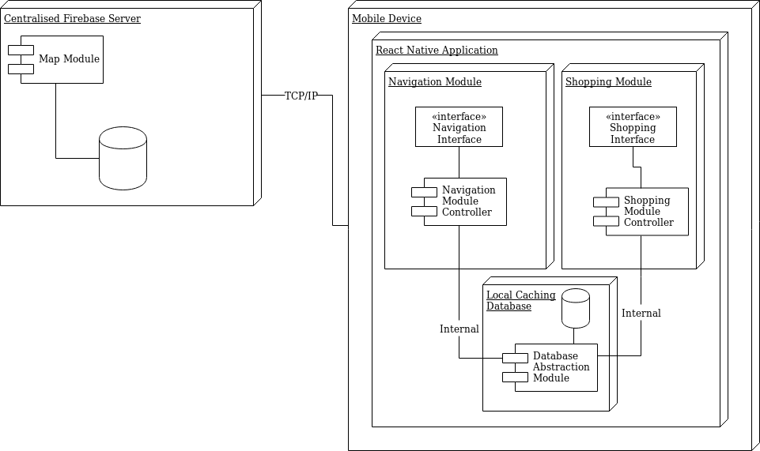
System Type
Interactive System – User Application
Event-Driven – Change in beacon ranges provide state changes that alter the system output

Slide 6
CORE QUALITY REQUIREMENTS
Scalability
We intend to have a user interface that allows mall owners to add stores to the list as well as supporting expanding maps.
We plan to use Firebase to ensure that our Database can keep up with the needs of the system.
2. Reliability
We intend to use beacons for accurate indoor navigation to specific shops.
3. Availability
We intend to use firebase cloud database hosting and offline synchronization to ensure that the database is always available

Slide 7
TECHNOLOGIES USED
REACT NATIVE - implementation
ZENHUB – Project Management tool
JEST – Integration testing
TRAVIS-CI – integration testing
Firebase – Database Manager

